Slide 1

Beverage company Performance Insights
Muhammad Satrio Pamungkas Suharoyo

Slide 2
Background
The company (established just 5 years ago), has already experienced rapid growth.
In 2018, its sales reached 5 million dollars.
Offers a unique and diverse range of products that define their distinctive identity.

Slide 3
Goals
Verifying inventory items completeness
Analyzing company performance to focus on marketing strategies and product development
Determining key vendors for purchasing and sales logistics
Identifying non-performing products

Slide 4
List of provided data
Beginning Inventory : List of inventory status at the beginning of Fiscal Year
Ending Inventory : List of inventory status at the end of Fiscal Year
Purchases : List of purchasing activities throughout the year
Sales : List of sales activities throughout the year

Slide 5
Beverage company LOGISTIC Insights

Slide 6
Verify inventory items completeness using SQL
Created a new variable called 'stock after purchase' by adding the initial stock with purchase data.
Created another new variable named 'remaining stock' by subtracting the 'stock after purchase' from sales data.
Validated the data by comparing the 'remaining stock' with the end-of-stock data.
After the data has been processed, several errors were identified.

Slide 7
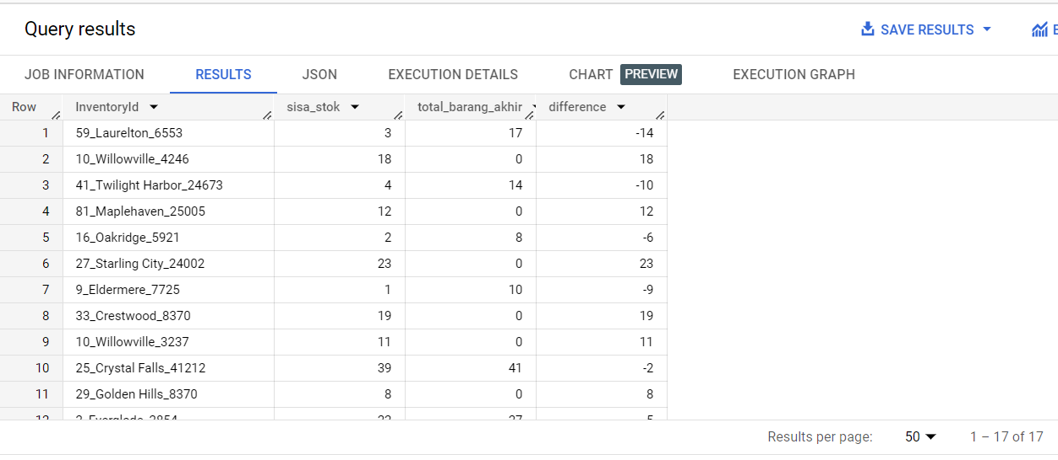
Problem 1
There is a discrepancy between the remaining stock variable I created and the end-of-year stock records from the provided table. There are 17 item types with differing records in both tables.

Slide 8
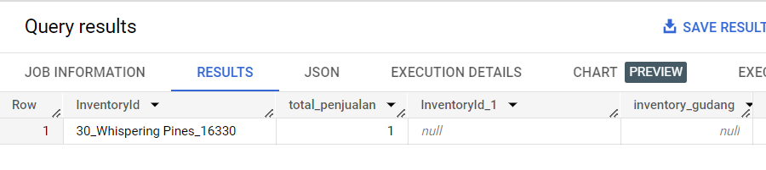
Problem 2
One item type is present in the sales data from the provided table, but it is missing from the 'stock after purchase' variable that I generated. This is not ideal in the company's business process.

Slide 9
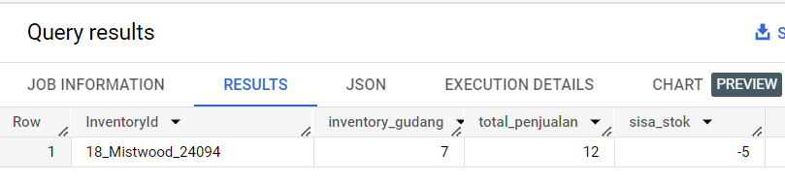
Problem 3
There is one item type with a total sales figure from the provided data that exceeds the total stock after purchase in the variable I created. This is not ideal in the company's business process.

Slide 10
Beverage company marketing strategy & PRODUC DEVELOPMENT

Slide 11
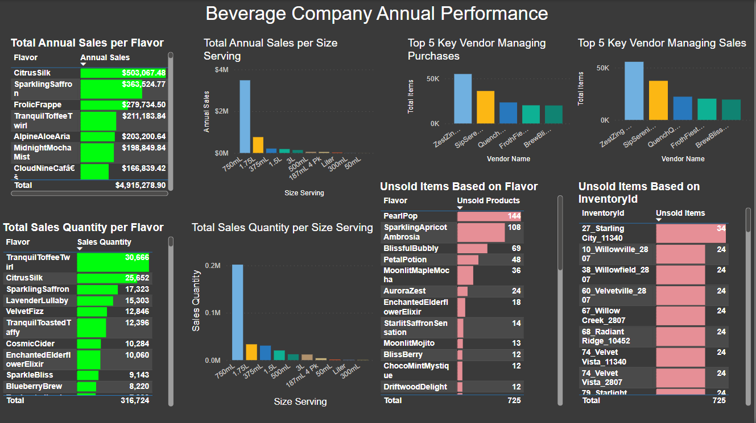

Slide 12
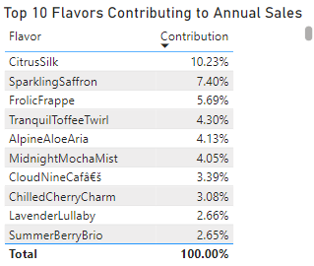
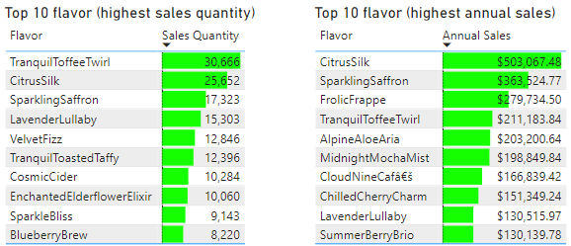
Top 10 flavor (highest sales)
Frolic Frappe is also not the product with the highest quantity of sales. However, it holds the third position as a significant contributor to the company's revenue.
Most of the products that make it into the top 10 as major revenue contributors for the company do not appear in the top 10 in terms of quantity of sales.
Evaluation in the marketing strategy to boost sales for some products such as Frolic Frappe, Tranquill Toffee Twirl, and Alpine Aloe Aria.

Slide 13
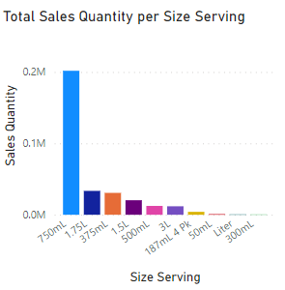
Total Sales per Size Serving
It is clear that the 750ml size is favored, with the highest total purchases among all sizes.
For the 300ml, 1 liter, and 50ml sizes, the continuation of their production needs to be considered.

Slide 14
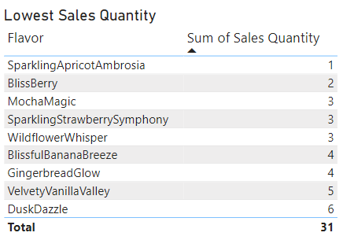
Lowest Sales Quantity
The sustainability of producing these products needs to be considered.
Need product development, such as flavor modifications.

Slide 15
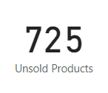
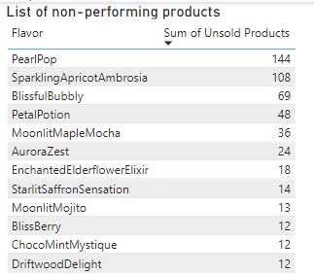
Non-Performing Products
There are 725 unsold items, with Pearl Pop contributing the most.
The continuation of producing Pearl Pop and Sparkling Apricot Ambrosia needs to be considered.

Slide 16
Beverage company MANAGINg KEY VENDOR

Slide 17
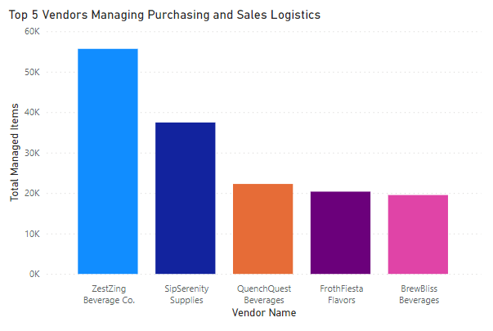
Key Vendors
Selecting the top 5 vendors is essential to enhance future logistics operations, making operations way more effective.
It is expected that company leadership will foster strong relationships with these 5 vendors to ensure smoother business operations.

Slide 18
CONCLUSION
The company's inventory recording practices need further attention, as there are several critical errors.
Evaluation is needed for the marketing strategy of certain products, such as Frolic Frappe, Tranquill Toffee Twirl, and Alpine Aloe Aria.
For underperforming products, the continuation of production should be questioned, or product development might be necessary.
The top 5 vendors have been selected as primary suppliers. It is expected that company leadership will foster strong relationships with these 5 vendors to ensure smoother business operations.

Slide 19

THANK YOU

